Slide 1
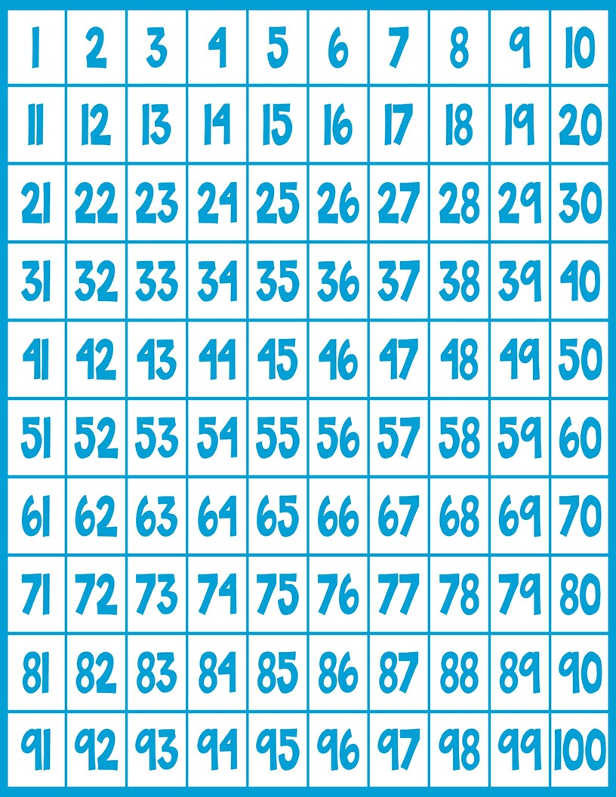
Days of School

Slide 2


Slide 3


Slide 4


Slide 5


Slide 6


Slide 7


Slide 8


Slide 9


Slide 10


Slide 11


Slide 12


Slide 13


Slide 14


Slide 15


Slide 16


Slide 17


Slide 18


Slide 19


Slide 20


Slide 21


Slide 22


Slide 23


Slide 24


Slide 25


Slide 26


Slide 27


Slide 28


Slide 29


Slide 30


Slide 31
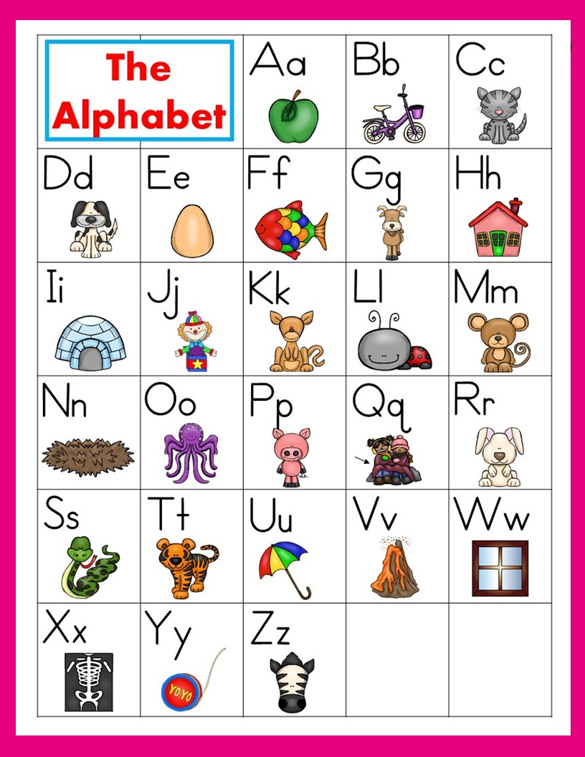

Slide 32


Slide 33


Slide 34


Slide 35


Slide 36


Slide 37


Slide 38


Slide 39


Slide 40


Slide 41


Slide 42


Slide 43


Slide 44


Slide 45


Slide 46


Slide 47


Slide 48


Slide 49


Slide 50


Slide 51


Slide 52


Slide 53


Slide 54


Slide 55


Slide 56


Slide 57


Slide 58


Slide 59


Slide 60


Slide 61


Slide 62


Slide 63


Slide 64


Slide 65


Slide 66


Slide 67


Slide 68


Slide 69


Slide 70


Slide 71


Slide 72


Slide 73


Slide 74


Slide 75


Slide 76


Slide 77


Slide 78


Slide 79


Slide 80


Slide 81


Slide 82


Slide 83


Slide 84


Slide 85


Slide 86


Slide 87


Slide 88


Slide 89

I

Slide 90
can

Slide 91
the

Slide 92
we

Slide 93
see

Slide 94
a

Slide 95
like

Slide 96
to

Slide 97
and

Slide 98
go

Slide 99
you

Slide 100
do

Slide 101
my

Slide 102
are

Slide 103
with

Slide 104
is

Slide 105
little

Slide 106
she

Slide 107
was

Slide 108
he

Slide 109
for

Slide 110
have

Slide 111
they

Slide 112
of

Slide 113
said

Slide 114
want

Slide 115
here

Slide 116
me

Slide 117
this

Slide 118
what

Slide 119
help

Slide 120
too

Slide 121
play

Slide 122
has

Slide 123
where

Slide 124
look

Slide 125
who

Slide 126
good

Slide 127
come

Slide 128
does

Slide 129
The
End

